Slide 1
Conditional Statements
Fundamentals of Python Programming Chapter 5

Slide 2
Chapter Content
The if statement
The if-else statement
The nested-if statement
The if-elif-else ladder

Slide 3
If Statement
The if statement is the most simple decision-making statement. It is used to decide whether a certain statement or block of statements will be executed or not.
if condition: statement1 statement2 # Here if the condition is true, if block # will consider only statement1 to be inside # its block.

Slide 4
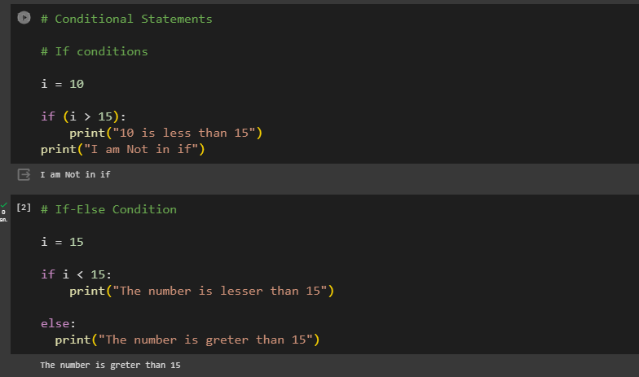
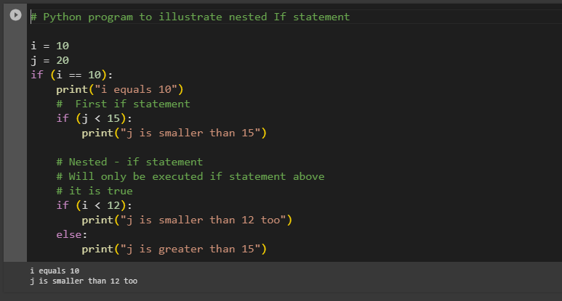
If condıtıons ın code

Slide 5
References
https://www.geeksforgeeks.org/python-programming-language/#python-operators

